Slide 1
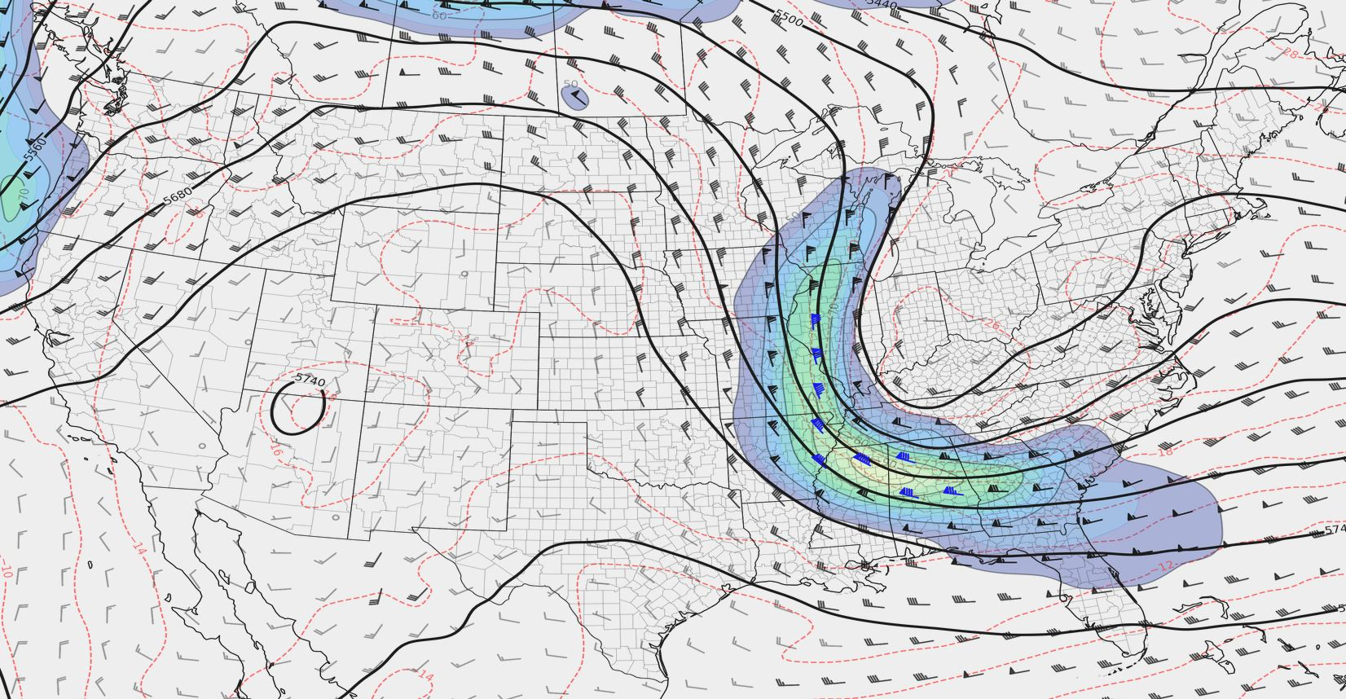
QG Height Tendency
Arranged by Andrew Moore
Material from Thomas Galarneau

Slide 2
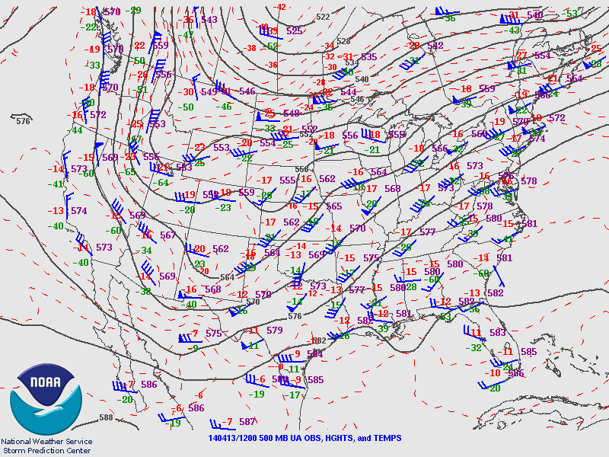
QG Height Tendency
Why do we care?
The QG height tendency equation allows us to anticipate:
The evolution of upper air and surface patterns
The evolution of certain severe weather parameters (e.g. shear, lift, etc…)
It is also relatively easy to use!
What will this pattern look like in 12-24 hours?

Slide 3
QG Height Tendency
A quick note:
There are alternatives to QG theory (for example, IPV theory), that will work just as well.
We will focus on QG theory in this class for two reasons:
It’s easy to interpret from basic weather charts
Most U.S. weather entities use QG theory (not the case elsewhere…)
What will this pattern look like in 12-24 hours?

Slide 4

Some Background Concepts
Mass Continuity:
We’re going to assume:
On synoptic scales, the troposphere is incompressible.
Hydrostatic approximation applies
Vertical velocity is zero at the surface and at the tropopause.
Because of mass continuity, any vertical motion is associated with horizontal convergence and divergence
W = 0
Divergence
>
w < 0
Level of Non-Divergence
<
<
Convergence
W = 0

Slide 5
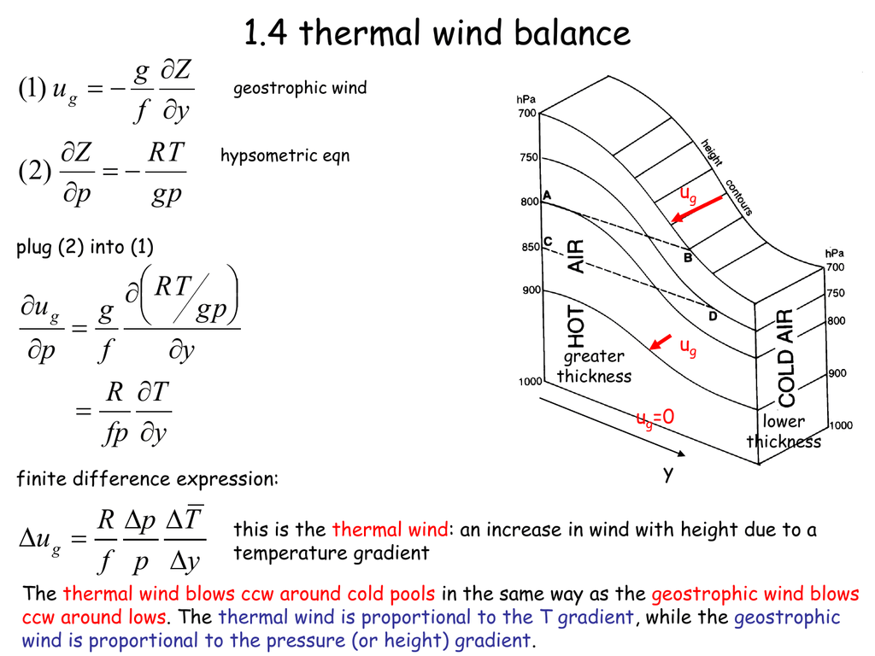
Some Background Concepts

Slide 6
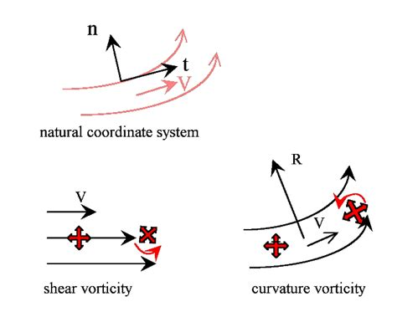
Some Background Concepts
Vorticity:
Vorticity is the curl of the wind field
Exists in all 3 dimensions, but for today we’ll only consider the X/Y dimensions
Vorticity can be generated by curvature in the flow and/or speed shear in the flow
Vorticity is directly related to vertical motions and convergence/divergence due to the conservation of angular momentum and conservation of mass

Slide 7
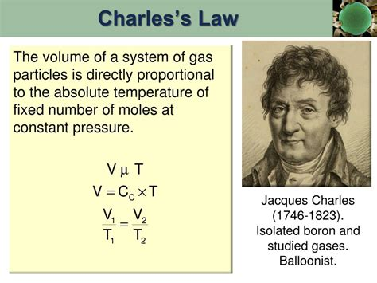
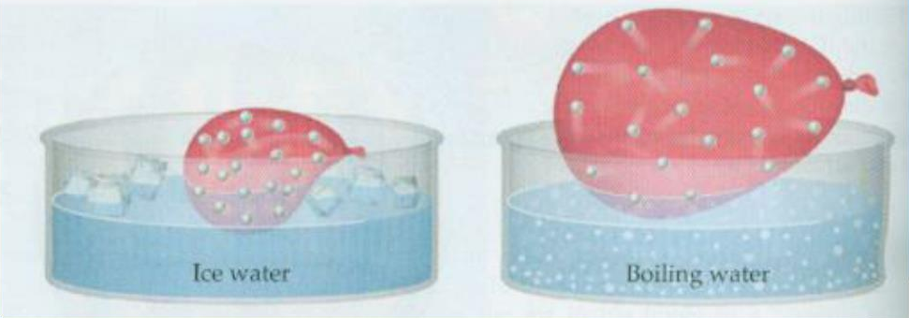
Physical Intuition
Charles’s Law
The volume of a gas is directly proportional to the temperature of the gas at a constant pressure.
If the gas heats up -> it expands!
If the gas cools down -> it contracts!

Slide 8
Physical Intuition
Consider a layer of the atmosphere in contact with the surface:
Warming the layer
Cooling the layer
Initial Height
Warming
Cooling
The ground can’t move - so the top of the layer must move!

Slide 9
Physical Intuition
Consider a layer of the atmosphere in contact with the surface:
Warming the layer
Cooling the layer
Final Height
Initial Height
(Expands)
Final Height
(Contracts)
The ground can’t move - so the top of the layer must move!

Slide 10
Physical Intuition
Consider a layer of the atmosphere above the surface:
Warming the layer
Cooling the layer
Initial Height 1
Warming
Cooling
Initial Height 2

Slide 11
Physical Intuition
Consider a layer of the atmosphere above the surface:
Warming the layer
Cooling the layer
Final Height 1
Initial Height 1
Final Height 1
(Expands)
(Contracts)
Final Height 2
Initial Height 2
Final Height 2

Slide 12
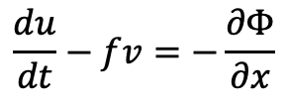
Physical Intuition
Geostrophic Vorticity:
Plug in geostrophic wind balance into the vorticity equation.
You end up with a form of geostrophic vorticity that relates to the Laplacian of the geopotential height field.
Thus, if you locally change the vorticity at a location, you must also change the geopotential height (i.e. thickness) field!
Consider this geopotential height field. What would vorticity look like?
y
- 4
x

Slide 13
Physical Intuition
Geostrophic Vorticity:
Plug in geostrophic wind balance into the vorticity equation.
You end up with a form of geostrophic vorticity that relates to the Laplacian of the geopotential height field.
Thus, if you locally change the vorticity at a location, you must also change the geopotential height (i.e. thickness) field!
Consider this geopotential height field. What would vorticity look like?
y
- 4
Positive
Vorticity
Negative
Vorticity
x
Use the thermal wind relation to confirm!

Slide 14
Physical Intuition
Geostrophic Vorticity:
Plug in geostrophic wind balance into the vorticity equation.
You end up with a form of geostrophic vorticity that relates to the Laplacian of the geopotential height field.
Thus, if you locally change the vorticity at a location, you must also change the geopotential height (i.e. thickness) field!
Consider this geopotential height field. What would vorticity look like?
y
- 4
x
If we change the geopotential height field, how will the vorticity field change (and vise versa)?

Slide 15
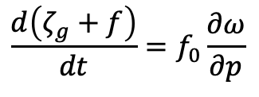
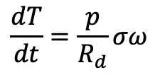
QG Vorticity and Thermo Equations
QG vorticity equation
Rate of change of absolute vorticity
Vertical motion
(or convergence/divergence)
See Bluestein Vol. 1 page 329 for details
QG thermodynamic equation
Vertical motion
(or expansion/contraction from vertical motion)
Rate of change of temperature

Slide 16
QG Height Tendency Equation
Differential thermal
advection
2nd derivative operator
Absolute vorticity advection
Diabatic heating

Slide 17

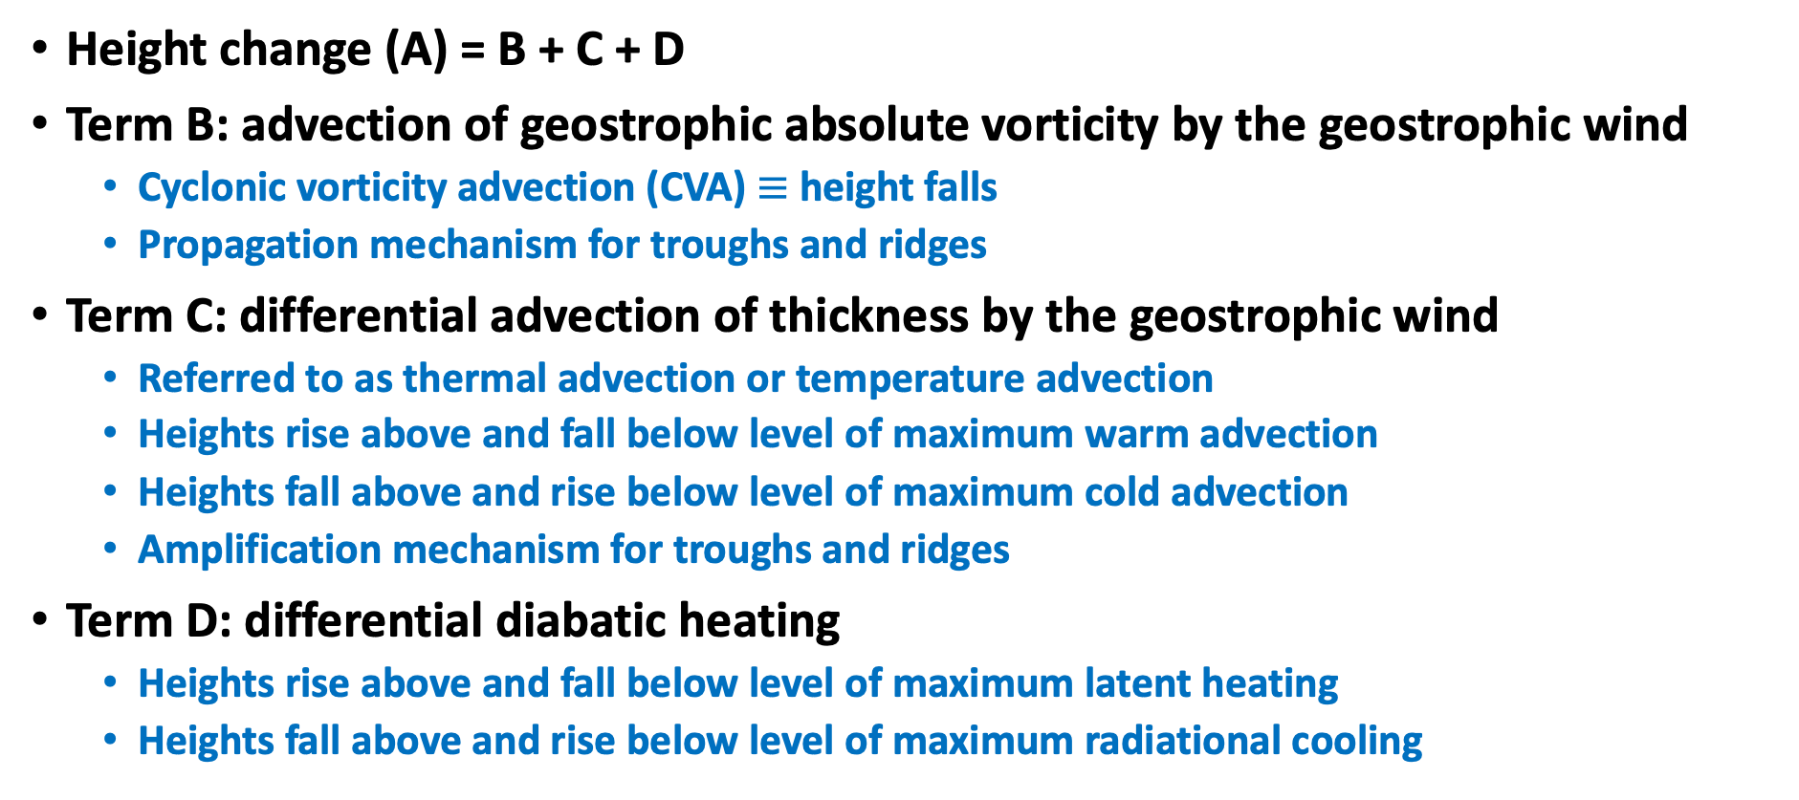
QG Height Tendency Equation
A B C D

Slide 18
QG X Breakdown
2nd Derivative Operator:
On synoptic scales, we can roughly assume that the height field (and thus the height tendency field) is sinusoidal.
Take the second derivative of a sine function:
d(d(sin(x)))
= d(cos(x))
= -sin(x)
This assumption turns the 2nd derivative operation into a simple minus sign!

Slide 19
QG X Breakdown
OR
Consider this case:
Advection of absolute vorticity:
This considers both relative vorticity (related to the height field) and planetary vorticity (related to the Coriolis force).
Here we see how moving the height field (more specifically, the Laplacian of the height field) can change the height field.
Vorticity Maximum
X
Vg = 0
Ug > 0

Slide 20
QG X Breakdown
OR
Consider this case:
Advection of absolute vorticity:
Advecting cyclonic vorticity (CVA) leads to height falls
Advecting anticyclonic vorticity (AVA) leads to height rises
Vorticity Maximum
X
Vg = 0
Ug > 0

Slide 21
QG X Breakdown
OR
Differential Thermal Advection
Assume:
Vg > 0
Ug = 0
P = 1000 mb
P = 925 mb
P = 850 mb
y
y
y
z
T - 2
T - 2
T - 2
Z 850
T - 1
T - 1
T
T - 1
Z 925
T + 1
T
T + 2
T
Z 1000
x
x
x
x

Slide 22
QG X Breakdown
OR
Differential Thermal Advection
Assume:
Vg > 0
Ug = 0
Consider only y component of thermal advection:
P = 1000 mb
y
Vg > 0
dT/dy < 0
-Vg(dT/dy) > 0
T - 2
T - 1
T
x
x

Slide 23
QG X Breakdown
OR
Differential Thermal Advection
Assume:
Vg > 0
Ug = 0
Consider only y component of thermal advection:
P = 925 mb
y
Vg > 0
dT/dy << 0
-Vg(dT/dy) >> 0
T - 2
T - 1
T
T + 1
T + 2
x

Slide 24
QG X Breakdown
OR
Differential Thermal Advection
Assume:
Vg > 0
Ug = 0
Consider only y component of thermal advection:
P = 850 mb
y
Vg > 0
dT/dy < 0
-Vg(dT/dy) > 0
T - 2
T - 1
T
x

Slide 25
QG X Breakdown
OR
Can’t forget this -1!
Differential Thermal Advection
Now consider differential portion between the pressure levels:
z
Between 850 - 925:
d(Tadv)/dP > 0
-1 * (positive value) = positive value
Z 850
Z 925
Between 925 - 1000:
d(Tadv)/dP < 0
Z 1000
-1 * (negative value) = negative value

Slide 26
QG X Breakdown
OR
Differential Thermal Advection
Now consider differential portion between the pressure levels:
z
Between 850 - 925:
Positive Value = Height Rises!
Z 850
Z 850
Z 920
Z 920
Between 925 - 1000:
Negative Value = Height Falls!
Z 1000
Z 1000

Slide 27
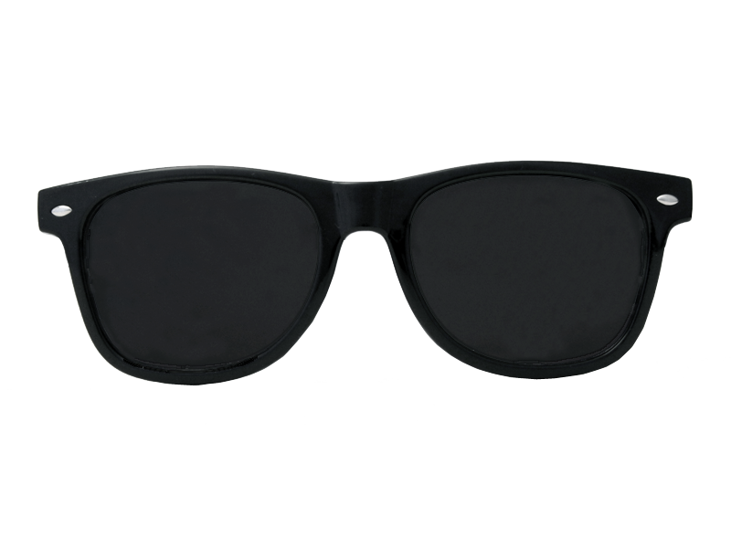
QG X Breakdown
OR
Differential Thermal Advection:
Warm air advection at a given pressure level induces height rises above that level, and height falls below that level
Cold air advection does the opposite: it cases height falls above the given pressure level, and height rises below.
This ties back directly to Charles’s Law!

Slide 28
QG X Breakdown
Diabatic Heating:
Similar in concept to differential thermal advection:
Diabatic heating in a layer causes the layer to expand;
Diabatic cooling in layer causes the layer to contract.
Causes height rises (falls) above (below) the source of heating.
Causes height rises (falls) below (above) the source of cooling
Examples:
  Latent heat release from large systems (hurricanes, large cyclones, etc…)
  Mesohighs in the wake of strong MCSs

Slide 29
QG X Breakdown
Warming the layer
Cooling the layer
Final Height 1
Initial Height 1
Final Height 1
Heating source
Cooling source
Final Height 2
Initial Height 2
Final Height 2

Slide 30
QG X Application
How do we use this?
Use the vorticity advection term to help anticipate where a vorticity maximum or minimum (i.e. a trough or a ridge) will go.
Use the differential thermal advection term to anticipate whether or not a trough or ridge will amplify.
The diabatic heating term is similar to the thermal advection term, but is typically not as consequential.

Slide 31
QG X Application
Z - 3
Conceptual Model:
Shortwave propagating through longwave
Z - 2
Z - 1
Xmax
Z
Xmin
Vg

Slide 32
QG X Application
Z - 3
Conceptual Model:
Shortwave propagating through longwave
Z - 2
Z - 1
Xmax
Xmin
Z
Vg

Slide 33
QG X Application
Z - 3
Conceptual Model:
Shortwave propagating through longwave
Z - 2
Z - 1
Xmax
Xmin
Z
Vg

Slide 34
QG X Application
Z - 3
Conceptual Model:
Shortwave Amplifying Longwave
Z - 2
L
Z - 1
Z

Slide 35
QG X Application
Z - 3
Conceptual Model:
Shortwave Amplifying Longwave
Z - 2
L
Height rises aloft in cold advection regime
Height falls aloft in cold advection regime
Z - 1
Z

Slide 36
QG X Examples
Focus on the shortwave trough in New Mexico.
Where is the vorticity maximum at?
Where will the 500 mb winds advect this vort. max?

Slide 37
QG X Examples
Focus on the shortwave trough in New Mexico.
Where is the vorticity maximum at?
Where will the 500 mb winds advect this vort. max?
X

Slide 38
QG X Examples
How about this shortwave over the northern Great Basin?
Where is the vorticity maximum?
Where will the geostropshic winds advect the vorticity?
X

Slide 39
QG X Examples
How about this shortwave over the northern Great Basin?
Where is the vorticity maximum?
Where will the geostropshic winds advect the vorticity?
X
X

Slide 40
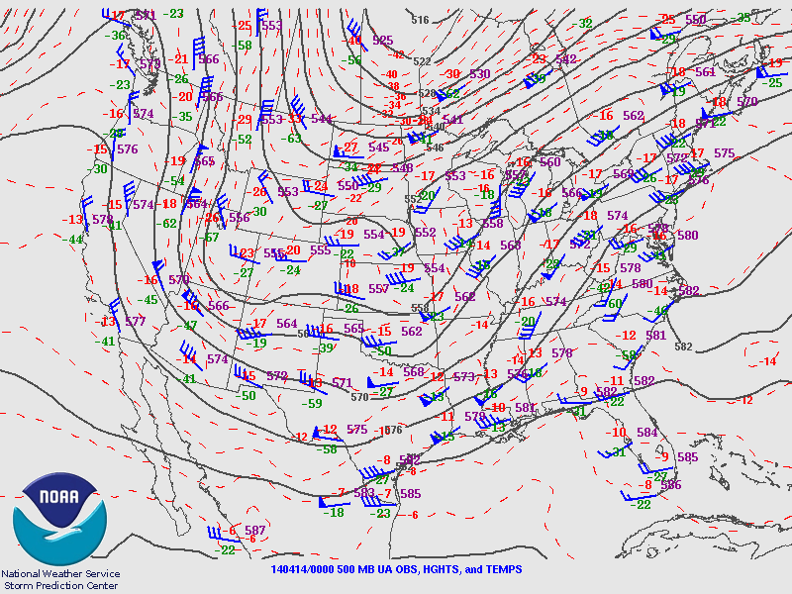
QG X Examples
Did this meet your expectations?
X
X

Slide 41
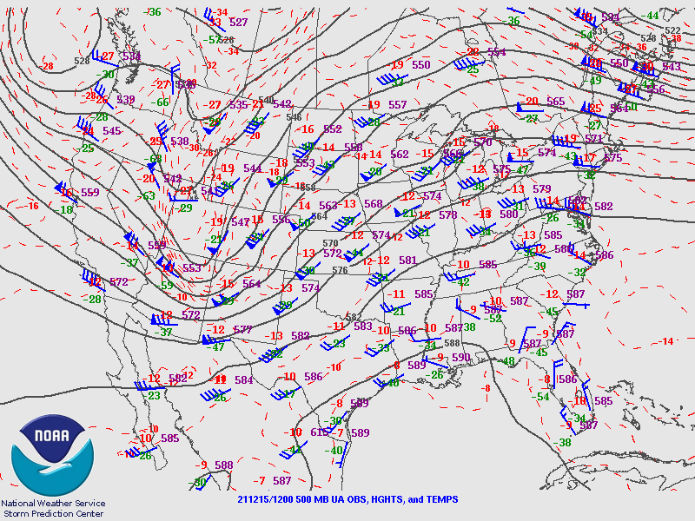
QG X Examples
How about this case?
Where do you think this trough will go in the next 12 hours?
(Choose A, B, C, or D)
A
X
B
C
D

Slide 42
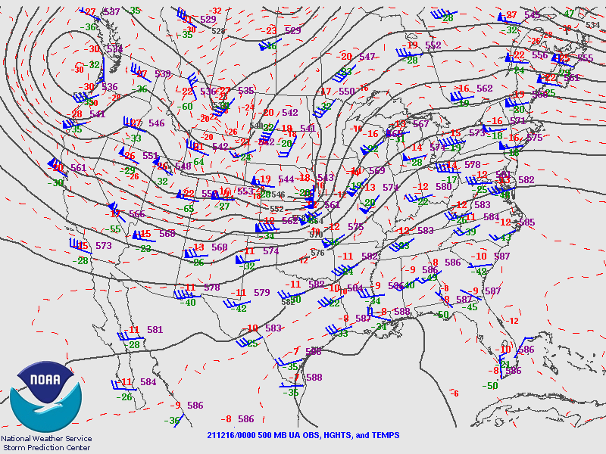
QG X Examples
How about this case?
Where do you think this trough will go in the next 12 hours?
(Choose A, B, C, or D)
A
X
B
C
D

Slide 43
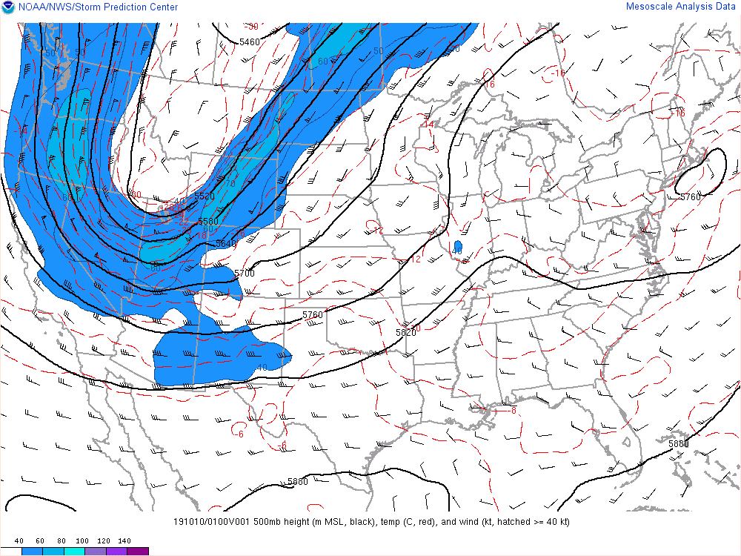
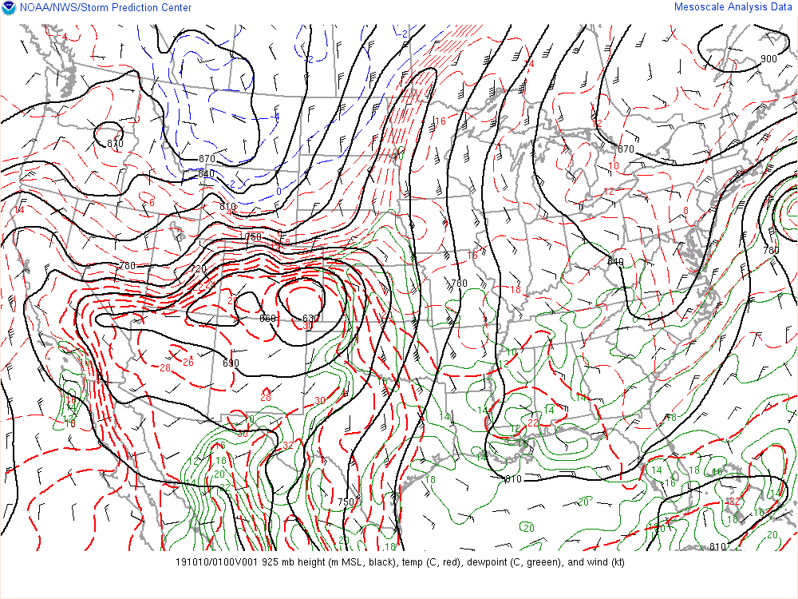
QG X Examples
Watch how the 500 mb trough deepens as the 925 mb cold front surges south into the Plains.
This is an example of differential thermal advection.

Slide 44
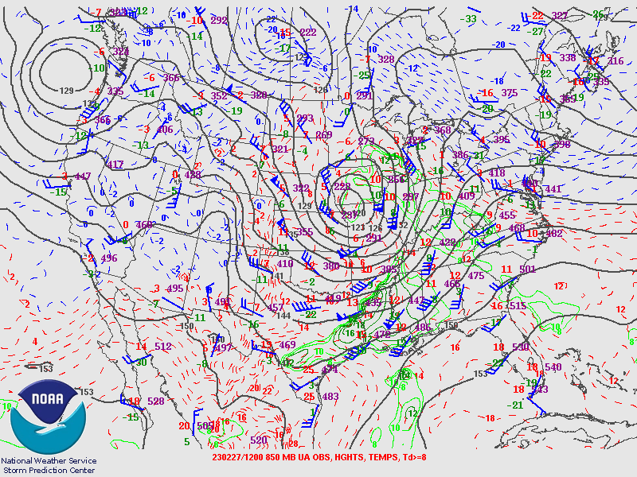
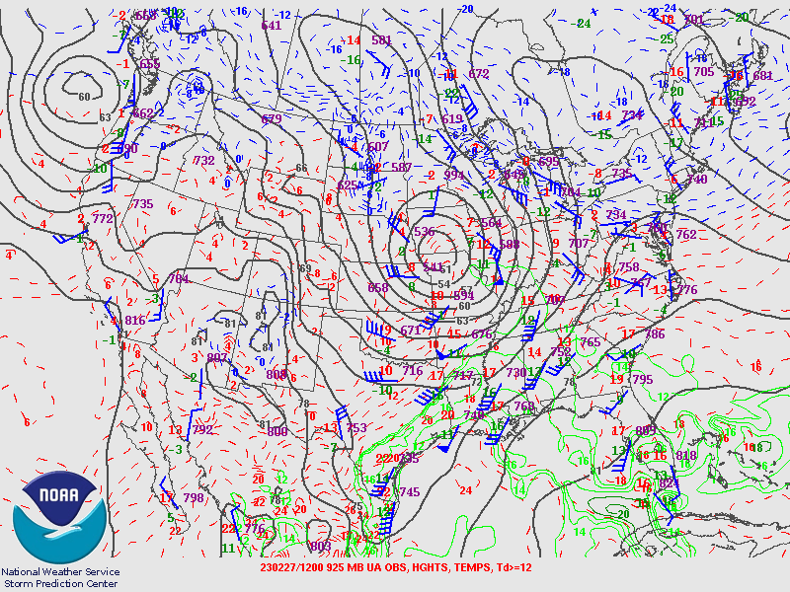
QG X Examples
Where is the strongest warm air advection at 850 mb?
This will tell you where the 925 mb low should go!

Slide 45
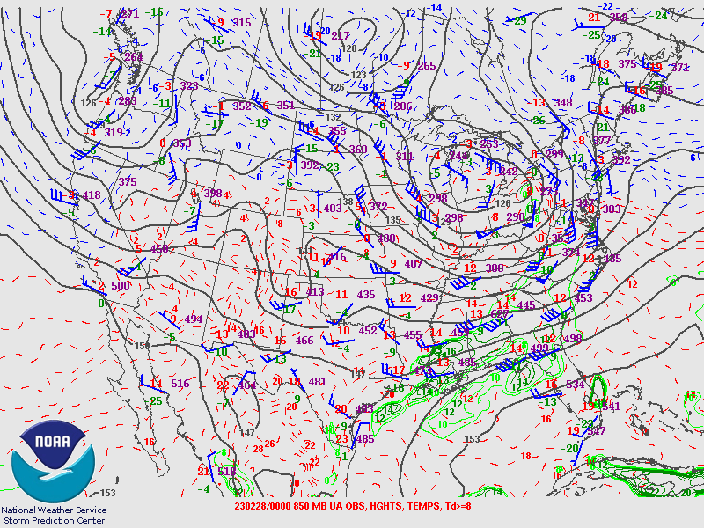
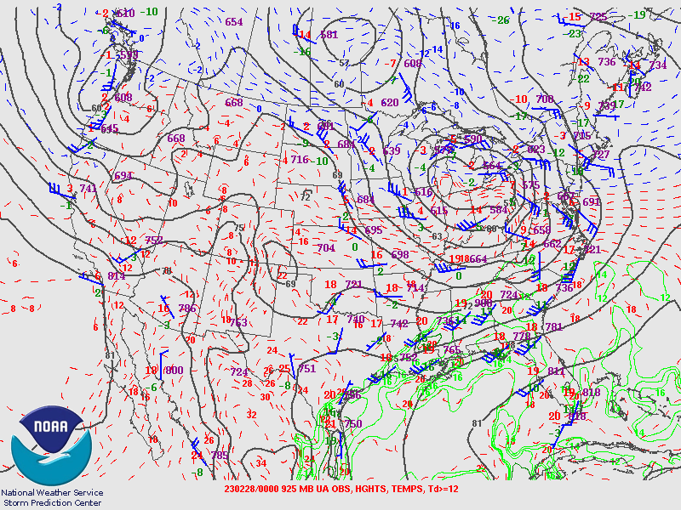
QG X Examples
Where is the strongest warm air advection at 850 mb?
This will tell you where the 925 mb low should go!

Slide 46
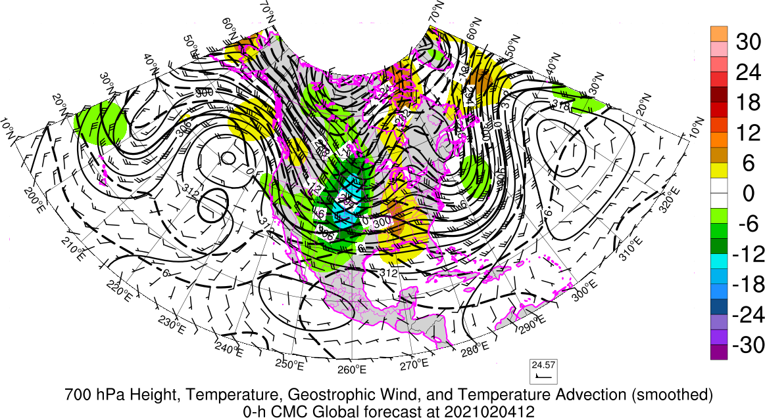
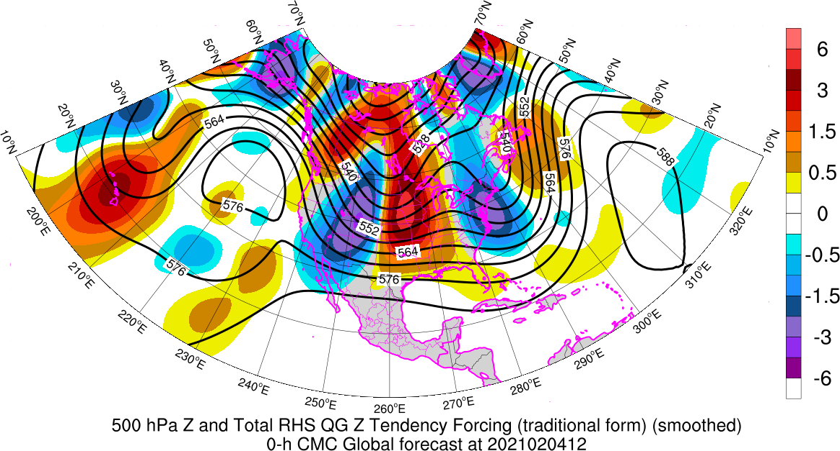
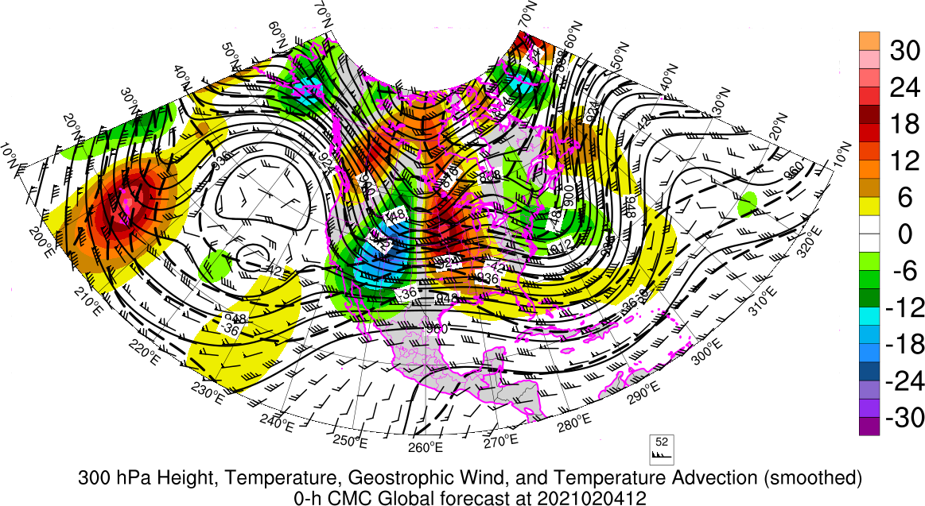
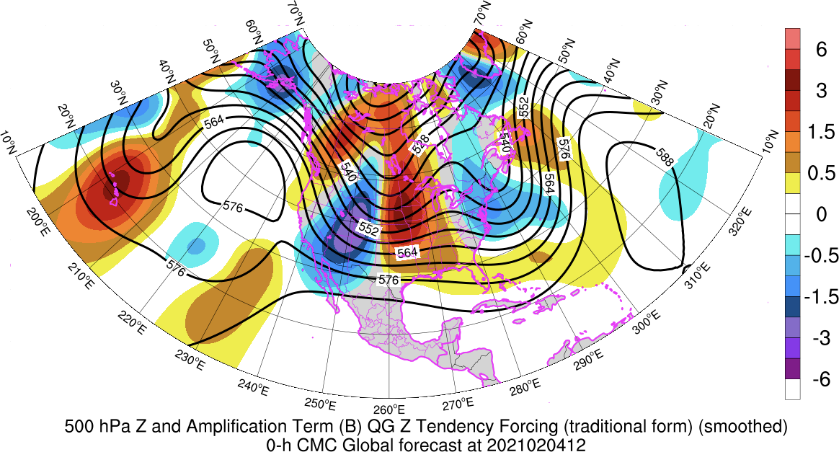
QG Resources
https://inside.nssl.noaa.gov/tgalarneau/real-time-qg-diagnostics/

Slide 47
Frontogenesis
Frontogenesis (frontolysis) is the strengthening (weakening) of a temperature gradient
In case of frontogenesis, thermal wind balance (TWB) is violated because temperature gradient is too strong for the given wind shear
  To restore TWB, atmosphere weakens temperature gradient via ascent (adiabatic cooling) on warm side and descent (adiabatic warming) on cold side of gradient
Fronts are zones where thermal advection and frontogenesis are easily enhanced and are also preferred corridors for cyclones/cyclogenesis

Slide 48
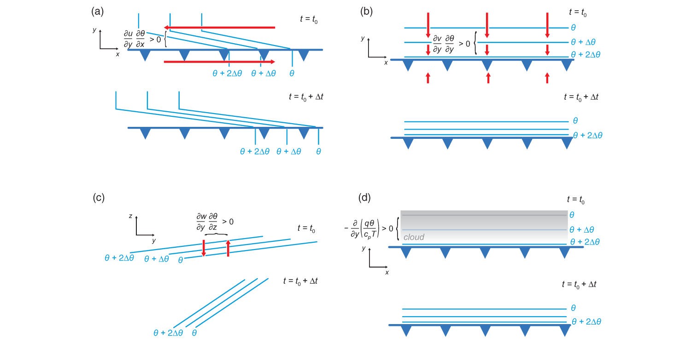
Frontogenesis Mechanisms
horizontal shear
confluence
tilting
Differential diabatic heating
Fig. 5.4 MR 2010

Slide 49
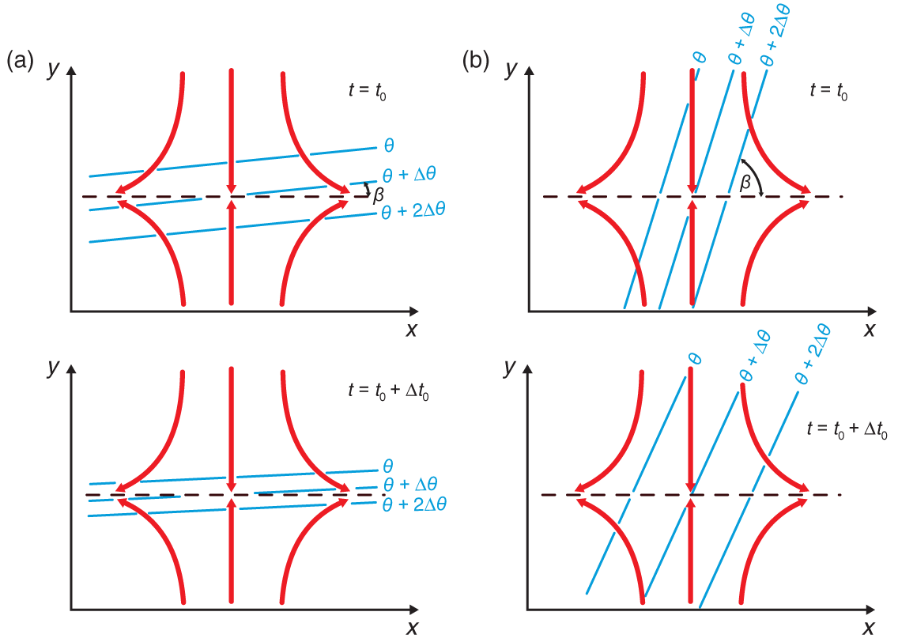
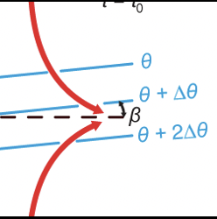
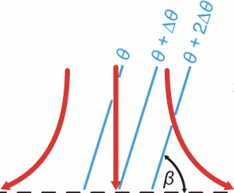
Frontogenesis and Frontolysis by Confluence
Like a jet entrance region: Frontogenesis!
Like a jet exit region: Frontolysis!
Fig. 5.5 MR 2010

Slide 50
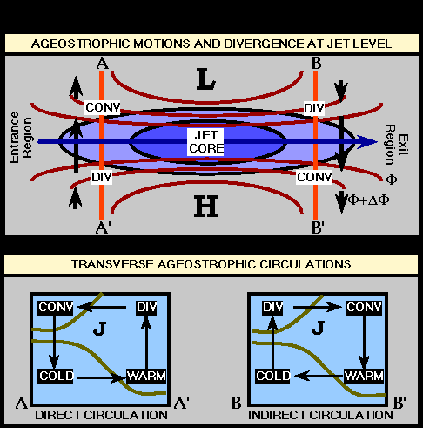
Frontogenesis and Jet Streaks
Air entering jet streak – sinking on cold side, rising on warm side.
Air leaving jet streak – rising on cold side, sinking on warm side.

Slide 51
Vertical Wind Shear
Where does it come from?
Secondary contributions:
Large accelerations of the horizontal wind due to large ageostropic winds
(think near jet streaks, areas of frontogenesis, and/or rapidly intensifying cyclones).
Erodes horizontal temperature gradient
(weaker thermal wind)
Enhances horizontal temperature gradient
(stronger thermal wind!)
For additional reading: M.R. 2010 and Doswell 1991

Slide 52
Frontogenesis and Jet Streaks
Jet streaks are coincident with strong temperature gradients (thermal wind balance!)
Air flows through a jet streak
  Encounters strengthening temperature gradient (frontogenesis) in entrance region
  Encounters weakening temperature gradient (frontogenesis) in exit region
Response to frontogenesis in entrance region is ascent on warm side (right entrance) and descent on cold side (left entrance)
Response to frontolysis in exit region is?

Slide 53
Baroclinic systems
Vorticity and thermal structure tilts westward (upstream) with height
  Deepening/strengthening systems
  Differential thermal advection leads to destabilization
Warm advection corresponds to veering winds with height
  Large clockwise turning hodographs in warm sector
Strong jet streaks and fronts are present

Slide 54
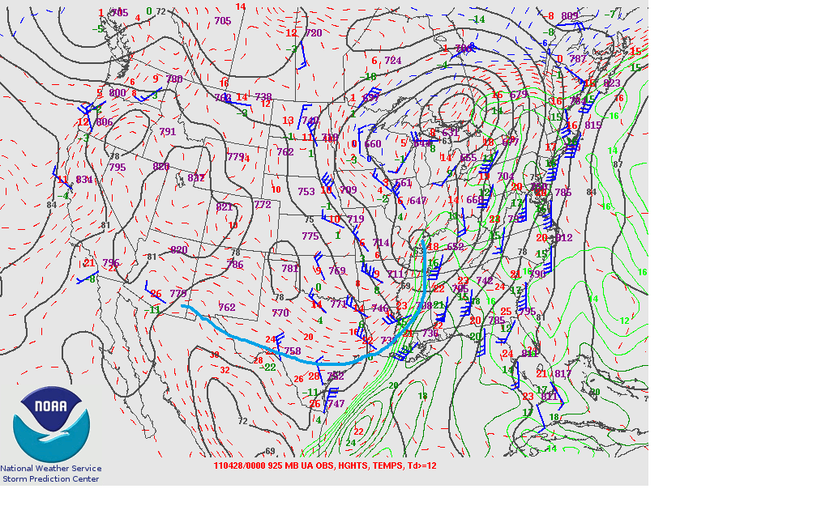
Edge of stronger gradient near ground
925mb

Slide 55
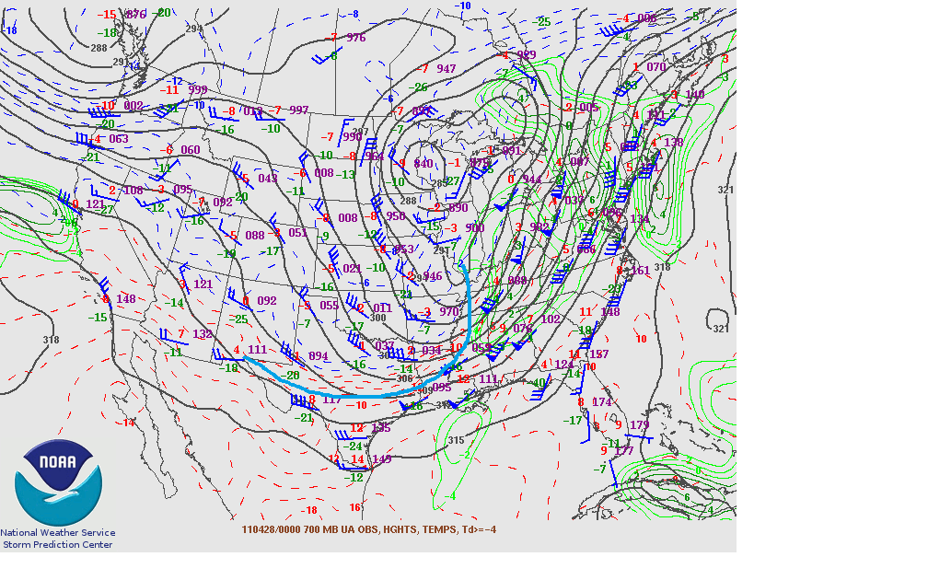
Temp gradient slopes NW with height
700mb

Slide 56
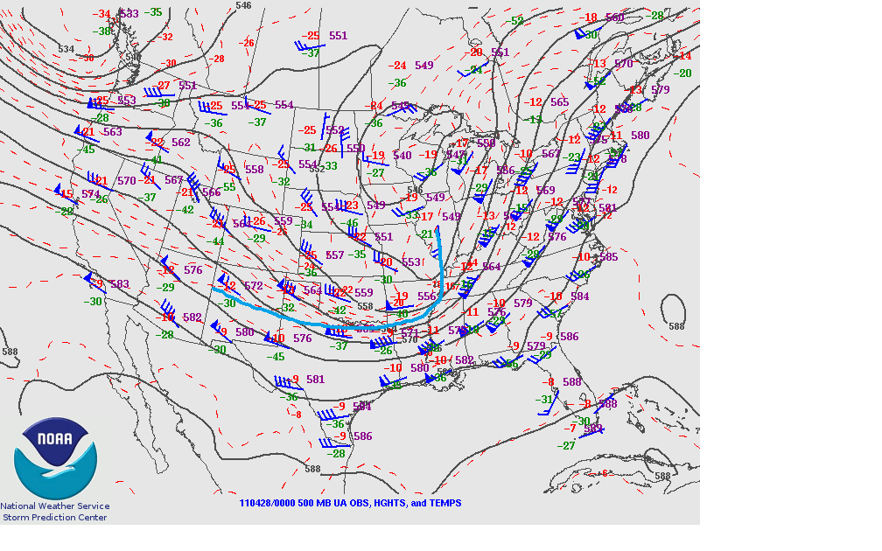
500mb

Slide 57
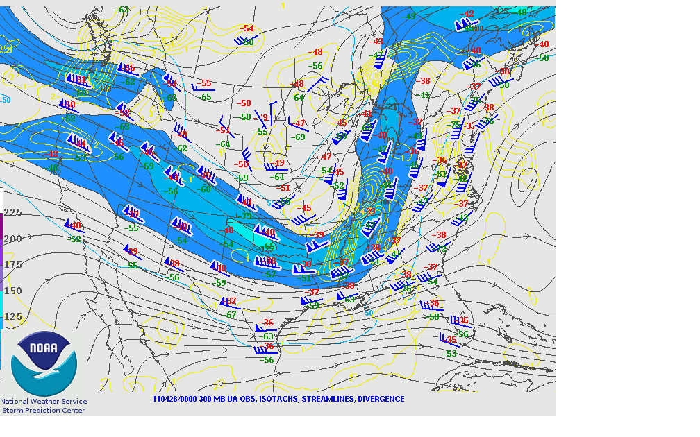
300mb

Slide 58
Equivalent Barotropic Systems
Vorticity and thermal structure vertically stacked with height
  Steady state or weakening systems
Minimal temperature advection corresponds to weak vertical shear
No feedback mechanism to intensify.
Weak gradients – weak flow – slow moving
Can even retrograde if large enough because planetary vorticity begins to dominate the relative component.

Slide 59
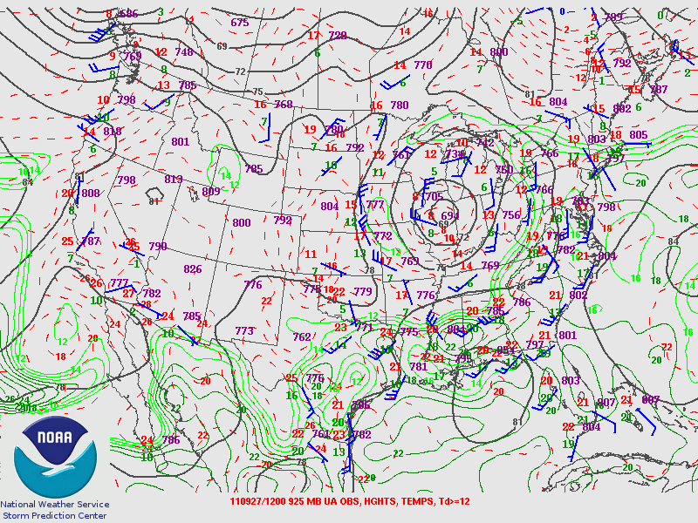

Slide 60
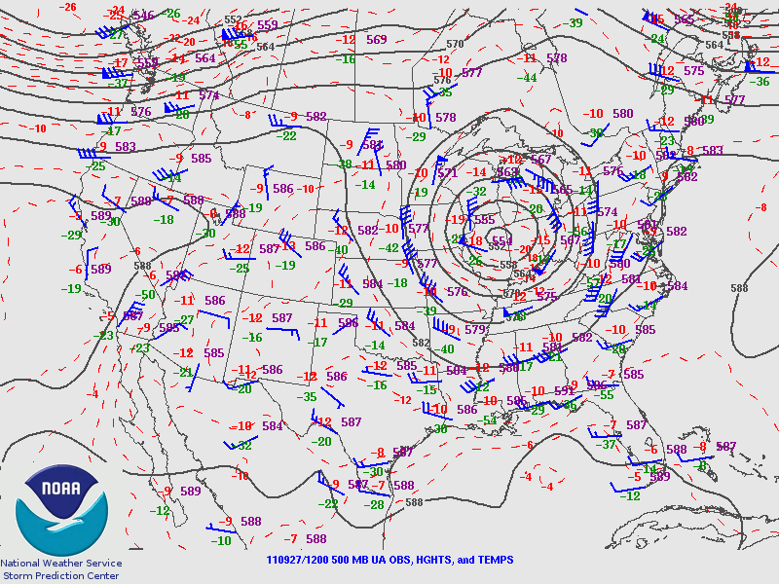

Slide 61
Final Comments
Can explain development of weather systems (QG height tendency and QG cyclogenesis)
Can explain why ascent occurs where it does near troughs, jets, and fronts
Look for gradients!
Synoptic-scale processes set the stage for severe thunderstorm development

